Slide 1






Ansible 1
utrains.org

Slide 2
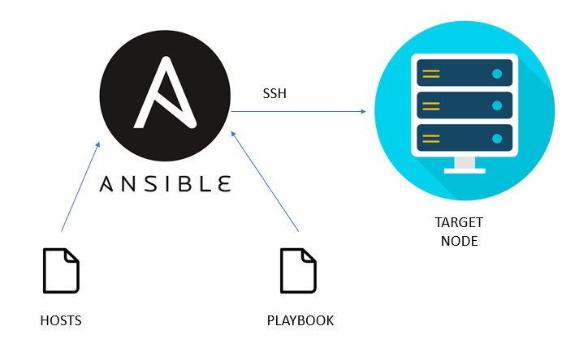
What is Ansible?

Slide 3
Table of content
What is Ansible?
How to use Ansible?
How does ansible work
Benefits of using ansible
Basic concepts and terms.
How to use Ansible

Slide 4



1.
Introduction
What is Ansible?
How does ansible work?
Benefits of using ansible
Basic concepts and terms

Slide 5
What is Ansible?
Ansible is an automation tool that can be used to:
Deploy many servers (up to thousands of servers in no time) in a scalable way
Deploy cloud infrastructure or on premises servers
Automate network devices configuration
etc.
Ansible uses SSH to connect to devices or servers
It is written in Python language
It is owned by Red Hat (Red Hat Ansible Automation Platform)

Slide 6


What is Ansible?
Ansible is also agentless:
You don’t need any agent on the servers you are accessing
This is different from tools like Puppet or Chef, that need an agent on the servers they are accessing
Ansible is push-based:
From the Ansible master, you push your changes to the target servers
The learning curve of Ansible is very easy (very detailed documentation)
Visit the ansible website at ansible.com
Here is the link to the Ansible latest Documentation ansible Docs

Slide 7








How does Ansible work?

Slide 8
How ansible works
Ansible uses the concepts of control and managed nodes.
It connects from the control node (any machine with Ansible installed), to the managed nodes sending commands and instructions to them.
The units of code that Ansible executes on the managed nodes are called modules.
Each module is invoked by a task, and an ordered list of tasks together forms a playbook.
Users write playbooks with tasks and modules to define the desired state of the system.
The managed machines are represented in a simplistic inventory file that groups all the nodes into different categories.

Slide 9
How ansible works
Ansible leverages a very simple language (YAML) to define playbooks in a human-readable data format that is really easy to understand from day one.
Even more, Ansible doesn’t require the installation of any extra agents on the managed nodes so it’s simple to start using it.
Typically, the only thing a user needs is a terminal to execute Ansible commands and a text editor to define the configuration files.

Slide 10
Benefits of using Ansible

Slide 11
Benefits of using Ansible
The following are some benefits of using Ansible:
It is free and open-source community project with a huge audience. so you can easily have solutions for your errors online.
Battle-tested over many years as the preferred tool of IT wizards.
Easy to start and use from day one, without the need for any special coding skills.
Simple deployment workflow without any extra agents.
Includes some sophisticated features around modularity and reusability that come in handy as users become more proficient.
Extensive and comprehensive official documentation that is complemented by a plethora of online material produced by its community.
To sum up, Ansible is simple yet powerful, agentless, community-powered, predictable, and secure.

Slide 12
Basic concepts and terms

Slide 13
Basic Concepts & Terms
The following are some concepts and terms used in the Ansible jargon
Host: A remote machine managed by Ansible.
Group: Several hosts grouped together that share a common attribute.
Inventory: A collection of all the hosts and groups that Ansible manages. Could be a static file in the simple cases or we can pull the inventory from remote sources, such as cloud providers.
Modules: Units of code that Ansible sends to the remote nodes for execution.
Tasks: Units of action that combine a module and its arguments along with some other parameters.

Slide 14
Basic Concepts & Terms
We also have:
Playbooks: An ordered list of tasks along with its necessary parameters that define a recipe to configure a system.
Roles: Redistributable units of organization that allow users to share automation code easier.
YAML: A popular and simple data format that is very clean and understandable by humans.

Slide 15
2.
How to use Ansible
Installation and Configuration

Slide 16
To start using Ansible, you will need to install it on a control node, this could be your laptop for example. From this control node, Ansible will connect and manage other machines and orchestrate different tasks.

Slide 17
How Ansible work ?
server
server
server
server
Ansible server
SSH
secure
yaml file
server
server
server
server
server
server
server
server
Master
Target servers

Slide 18
Setting up our Ansible Lab
CentOS 6 container
Ansible server
SSH
secure
yml file
CentOS 6 container
Master
Target servers

Slide 19
We are going to use 3 virtual machines, one will be the control node with ansible installed and the other two will be host servers.
To create your environment on AWS follow this confluence page: Link here

Slide 20
We just saw an introduction to ansible, we have also done a hands on project on how ansible master connects to the various nodes and how you can connect to these nodes using ssh-keys.
In the Next lesson, we will see more about about ansible playbook, ansible roles and ansible tower

Slide 21
Read more
https://docs.ansible.com/ansible/latest/collections/ansible/builtin/user_module.html
https://docs.ansible.com/ansible

Slide 22

Thanks!
Any questions?
You can find us at:
website: https://utrains.org/
Phone: +1 (302) 689 3440
Email: contact@utrains.org

Slide 23
Click on the link below to contact the support team for any issue!
https://utrains.org/support/
Create a ticket for your problem and we will get back to you soon!

